Slide 1
1
Agile Project Management Methodology

Slide 2
What is a Project Management Methodology?
2
A project management methodology is a set of principles and practices that guide you in organizing your projects to ensure their optimum performance.
Project management is so important to organizations and teams, but in order for it to be really effective, you need to make sure you’re correctly mapping your project management methodology to your team type, project, organization, and goals.

Slide 3
Agile Methodology
3
Agile is a software development methodology to build a software incrementally using short iterations of 1 to 4 weeks so that the development process is aligned with the changing business needs. Instead of a single-pass development of 6 to 18 months where all the requirements and risks are predicted upfront, Agile adopts a process of frequent feedback where a workable product is delivered after 1 to 4-week iteration.

Slide 4
The key principles of agile project management methodologies are:
4
It’s collaborative.
It’s quick.
It’s open to data-driven change.
As such, agile project management methodologies usually involve short phases of work with frequent testing, reassessment, and adaptation throughout.
In many agile methods, all of the work to be done is added to a backlog that teams can work through in each phase or cycle, with project managers or product owners prioritizing the backlog so teams know what to focus on first.

Slide 5
What are the 4 core values of Agile?
5
1. Individuals and interactions over processes and tools
2. Working software over comprehensive documentation
3. Customer collaboration over contract negotiation
4. Responding to change over following a plan

Slide 6
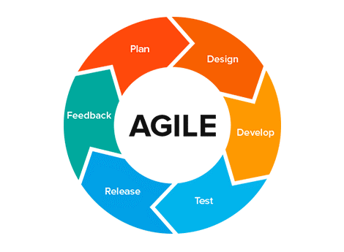
What are the 6 steps in the Agile methodology?
6
1. Project planning
2. Product roadmap creation
3. Release planning
4. Sprint planning
5. Daily stand-ups
6. Sprint review and retrospective

Slide 7

1. Project planning
7
Like with any project, before beginning your team should understand the end goal, the value to the organization or client, and how it will be achieved.
You can develop a project scope here, but remember that the purpose of using Agile project management is to be able to address changes and additions to the project easily, so the project scope shouldn’t be seen as unchangeable.

Slide 8

2. Product roadmap creation
8
A roadmap is a breakdown of the features that will make up the final product. This is a crucial component of the planning stage of Agile, because your team will build these individual features during each sprint.
At this point, you will also develop a product backlog, which is a list of all the features and deliverables that will make up the final product. When you plan sprints later on, your team will pull tasks from this backlog.

Slide 9
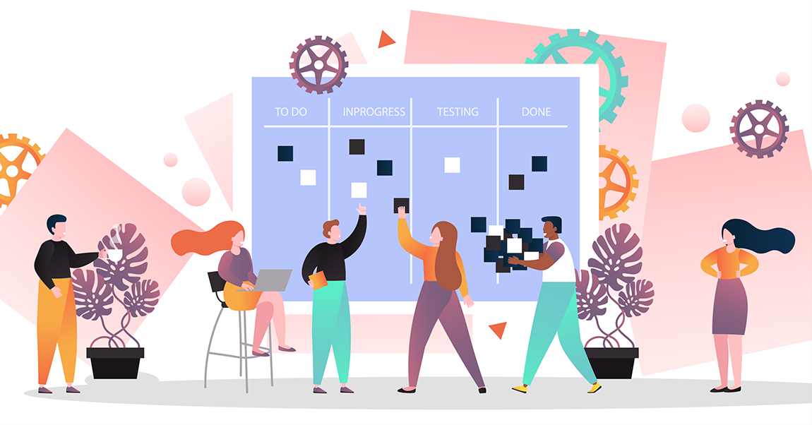
3. Release planning
9
In traditional waterfall project management, there is one implementation date that comes after an entire project has been developed. When using Agile, however, your project uses shorter development cycles (called sprints) with features released at the end of each cycle.
Before kicking off the project, you’ll make a high-level plan for feature releases and at the beginning of each sprint, you’ll revisit and reassess the release plan for that feature.

Slide 10

4. Sprint planning
10
Before each sprint begins, the stakeholders need to hold a sprint planning meeting to determine what will be accomplished by each person during that sprint, how it will be achieved, and assess the task load. It’s important to share the load evenly among team members so they can accomplish their assigned tasks during the sprint.
You’ll also need to visually document your workflow for team transparency, shared understanding within the team, and identifying and removing bottlenecks.

Slide 11

5. Daily stand-ups
11
To help your team accomplish their tasks during each sprint and assess whether any changes need to be made, hold short daily stand-up meetings. During these meetings, each team member will briefly talk about what they accomplished the day before and what they will be working on that day.
These daily meetings should be only 15 minutes long. They aren’t meant to be extended problem-solving sessions or a chance to talk about general news items. Some teams will even hold these meetings standing up to keep it brief.

Slide 12

6. Sprint review and retrospective
12
After the end of each sprint, your team will hold two meetings: first, you will hold a sprint review with the project stakeholders to show them the finished product. This is an important part of keeping open communication with stakeholders. An in-person or video conference meeting allows both groups to build a relationship and discuss product issues that arise.
Second, you will have a sprint retrospective meeting with your stakeholders to discuss what went well during the sprint, what could have been better, whether the task load was too heavy or too light for each member, and what was accomplished during the sprint.

Slide 13
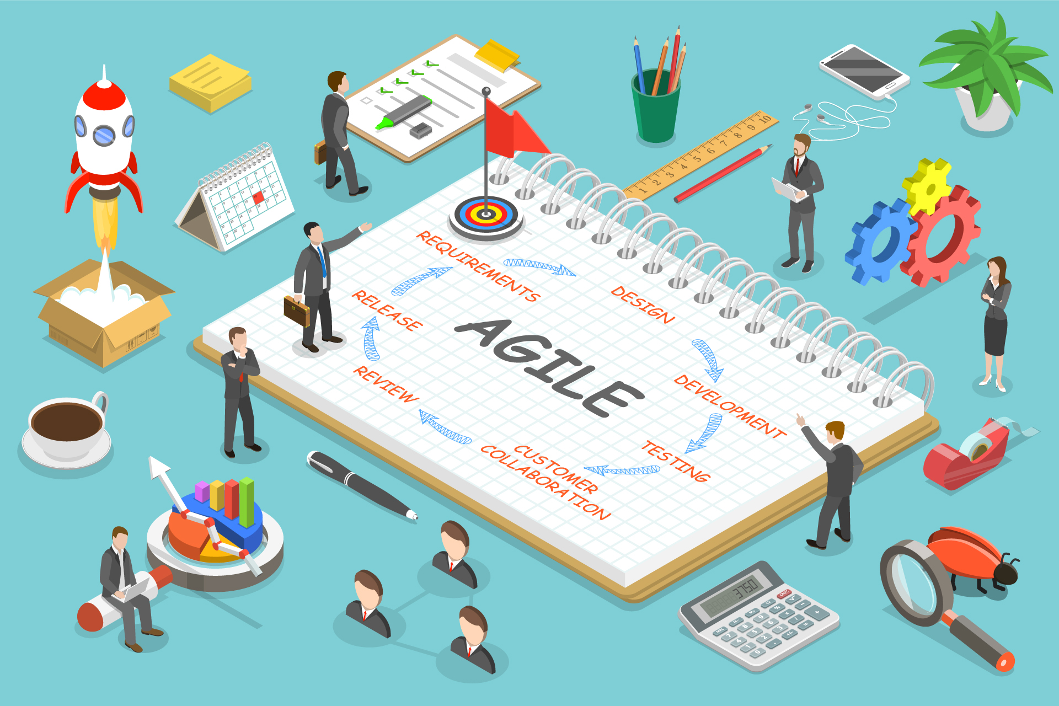
Conclusion
13
These are the most basic and important parts of Agile project management. As you transition your team to an Agile methodology, these processes, Agile software and tools, roles, and principles will help you change your mindset and begin working together to be more flexible and adapt to changes as they come. Agile isn’t for everyone, but teams who use it correctly will experience enormous benefits, including streamlined work processes and rapid innovation.

Slide 14
14
Thank You
Prepared By : Ashwini Jadhav (17101B0038)
B.E. INFT-B
Guided By : Prof. Yash Shah

